Slide 1

GAME ANALYSIS
with SQL
Mentorness Internship Project by
Divyank Yadav

Slide 2
Content
Project Overview
Dataset Description
Analysis (Queries)
Summary

Slide 3
Project Overview
Studying gameplay data to identify key metrics and patterns.
Understanding how game elements influence player strategies.
Providing insights to help developers enhance gaming experiences.
Project encompasses data exploration, query formulation, result interpretation and data visualization techniques.

Slide 4
Dataset Description
The
Player Details Table:
`P_ID`: Player ID
`PName`: Player Name
`L1_status`: Level 1 Status
`L2_status`: Level 2 Status
`L1_code`: System generated Level 1 Code
`L2_code`: System generated Level 2 Code
Level Details Table:
`P_ID`: Player ID
`Dev_ID`: Device ID
`start_time`: Start Time
`stages_crossed`: Stages Crossed
`level`: Game Level
`difficulty`: Difficulty Level
`kill_count`: Kill Count
`headshots_count`: Headshots Count
`score`: Player Score
`lives_earned`: Extra Lives Earned

Slide 5
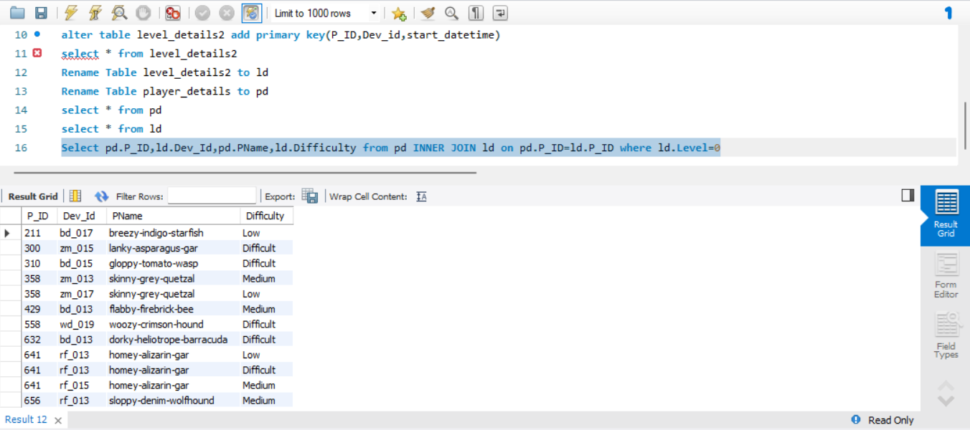
Analysis
(Queries)
Query – 1)
Extract P_ID, Dev_ID, PName and
Difficulty_level of all players at level 0.
SELECT pd.P_ID, ld.Dev_ID,
pd.PName, ld.difficulty
FROM Player_Details pd
INNER JOIN Level_Details ld ON
pd.P_ID = ld.P_ID
WHERE ld.level = 0;
Analysis -- It performs an inner join on
the Player ID column between the two
tables to retrieve matching records based
on the Player ID.

Slide 6
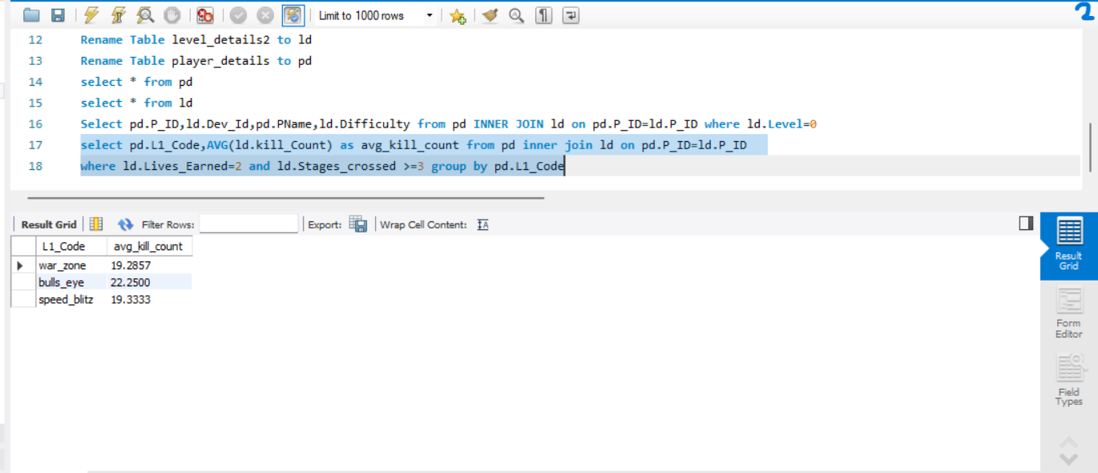
Query – 2)
Find Level1_code wise Avg_Kill_Count
where lives_earned is 2 and atleast 3 stages
are crossed.
SELECT pd.L1_code, AVG(ld.kill_count)
AS avg_kill_count
FROM Player_Details pd
INNER JOIN Level_Details ld ON pd.P_ID
= ld.P_ID
WHERE ld.lives_earned = 2 AND
ld.stages_crossed >= 3
GROUP BY pd.L1_code;
Analysis -- It performs an inner join on the
Player ID column between Player_Details
and Level_Details tables to retrieve
matching records based on the Player ID.
The result is grouped by L1_code.

Slide 7
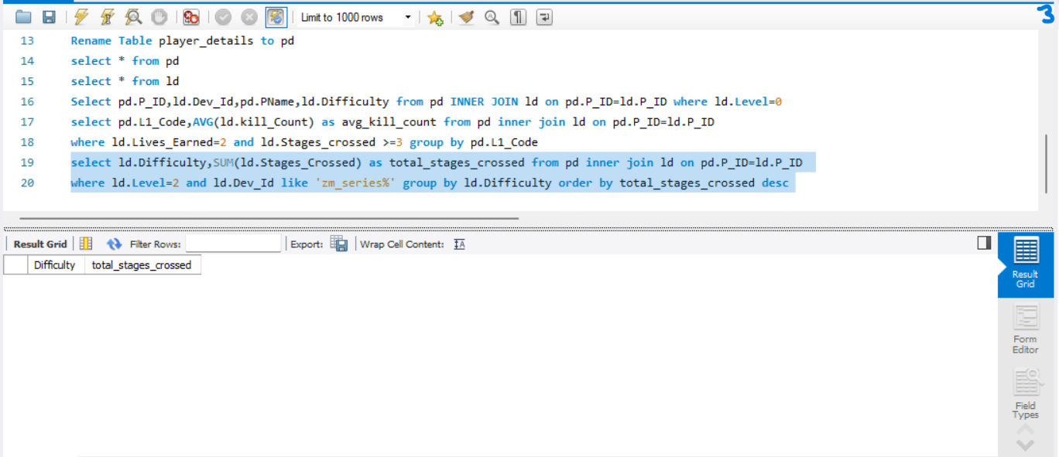
Query – 3)
Find the total number of stages crossed at each
diffuculty level where for Level2 with players use
zm_series devices. Arrange the result.
SELECT ld.difficulty, SUM(ld.stages_crossed) AS
total_stages_crossed
FROM Level_Details ld
INNER JOIN Player_Details pd ON ld.P_ID =
pd.P_ID
WHERE ld.level = 2 AND ld.Dev_ID LIKE
'zm_series%'
GROUP BY ld.difficulty
ORDER BY total_stages_crossed DESC;
Analysis -- It performs an inner join with the
Player_Details table based on the Player ID. The
result is grouped by difficulty and ordered by the
total number of stages crossed in descending order.

Slide 8
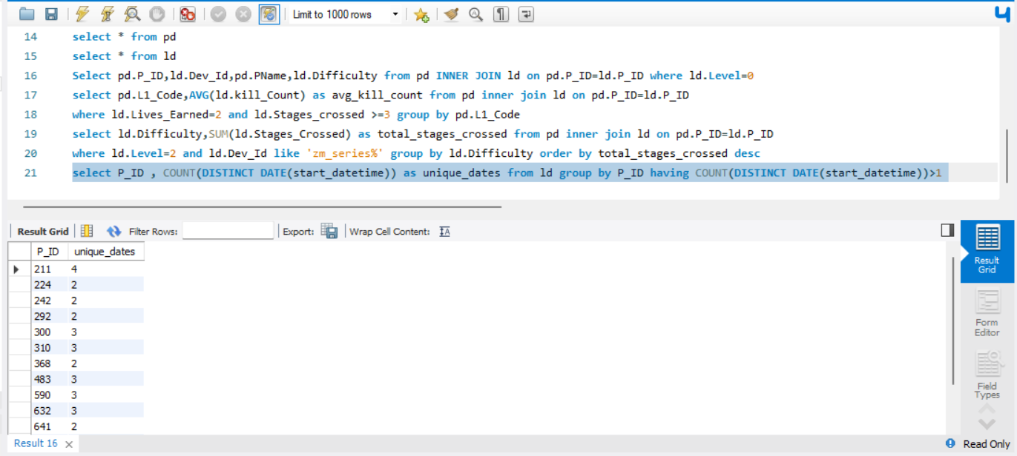
Query – 4)
Extract P_ID and the total number of unique
dates for those players who have played games
on multiple days.
SELECT P_ID, COUNT(DISTINCT
DATE(start_datetime)) AS Unique_Dates
FROM Game_Data
GROUP BY P_ID
HAVING COUNT(DISTINCT
DATE(start_datetime)) > 1;
Analysis -- It groups the results by P_ID and
filters out the groups where the count of
unique dates is greater than 1. This query helps
identify players who have started games on
multiple dates.

Slide 9
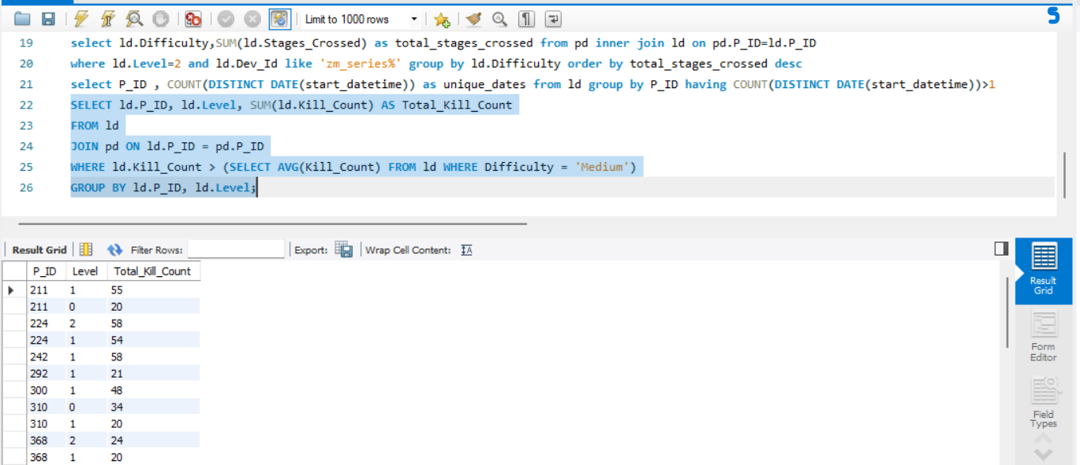
Query – 5)
Find P_ID and level wise sum of kill_counts where kill_count is greater than avg kill
count for the Medium difficulty.
SELECT P_ID, Level, SUM(Kill_Count) AS
Total_Kill_Count
FROM Game_Data
WHERE Kill_Count > (SELECT
AVG(Kill_Count) FROM Game_Data
WHERE Difficulty_level = 'Medium')
GROUP BY P_ID, Level;
Analysis -- It filters the data based on the condition that the Kill_Count is greater than the average Kill_Count for records with the Difficulty_level set to 'Medium'. Finally, it groups the results by P_ID and Level. This query helps identify players who have achieved above-average kill counts in levels classified as 'Medium' difficulty.

Slide 10
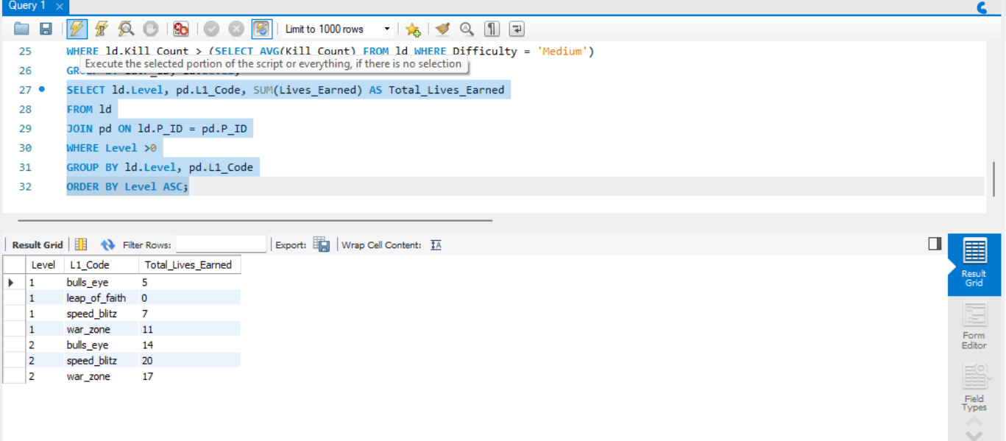
Query – 6)
Find Level and its corresponding Level code wise sum of lives earned excluding level 0. Arrange in asecending order of
level.
SELECT Level, Level_code,
SUM(lives_earned) AS Total_Lives_Earned
FROM Game_Data
WHERE Level > 0
GROUP BY Level, Level_code
ORDER BY Level ASC;
Analysis -- It filters the data to exclude Level 0, which typically represents the initial level or setup phase. Then, it calculates the sum of lives earned for each level and groups the results by Level and Level_code. Finally, it orders the results by Level in ascending order.

Slide 11
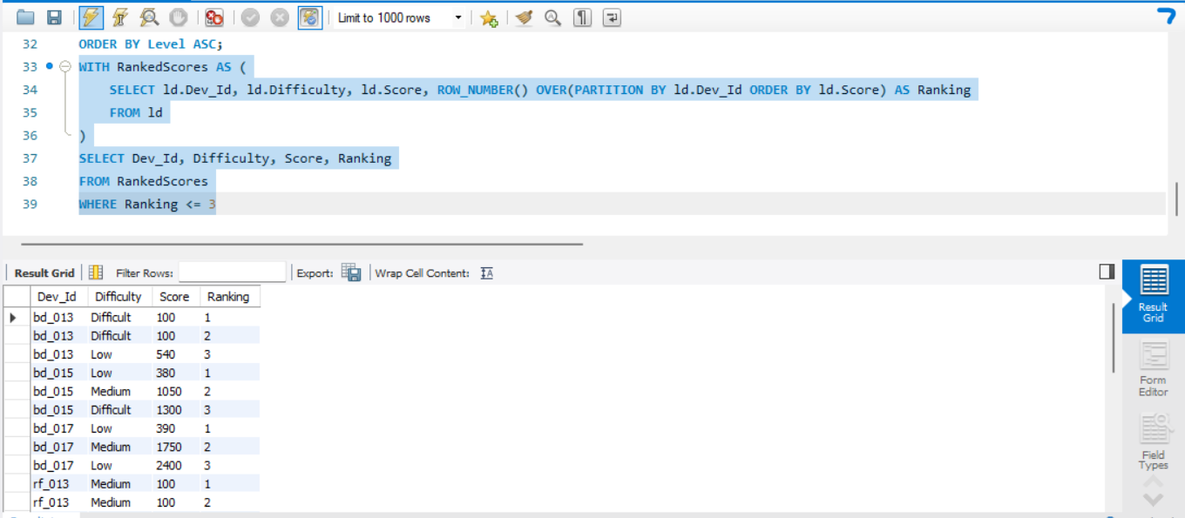
Query – 7)
Find Top 3 score based on each dev_id and Rank
them in increasing order using Row_Number.
Display difficulty as well.
WITH RankedScores AS (SELECT Dev_ID,
Difficulty_level, Score, ROW_NUMBER()
OVER(PARTITION BY Dev_ID ORDER BY Score
DESC) AS Rank FROM Game_Data)
SELECT Dev_ID, Difficulty_level, Score, Rank
FROM RankedScores
WHERE Rank <= 3;
Analysis -- By partitioning the data by Developer ID
and ranking scores within each group, the query
efficiently retrieves the highest scores. The main
query then selects the Developer ID, Difficulty
Level, Score, and Rank from the TopScores CTE,
ensuring only the top three scores are included for
each developer.

Slide 12
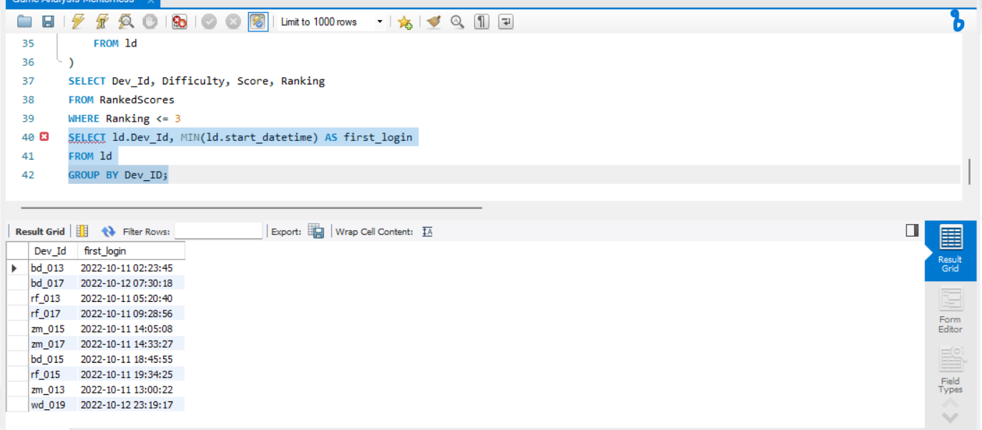
Query – 8)
Find first_login datetime for each device id.
SELECT Dev_ID, MIN(start_datetime) AS
first_login
FROM Game_Data
GROUP BY Dev_ID;
Analysis -- The SQL query retrieves the
earliest login timestamp for each developer
by selecting the minimum start datetime
grouped by the developer's ID from the
Game_Data table

Slide 13
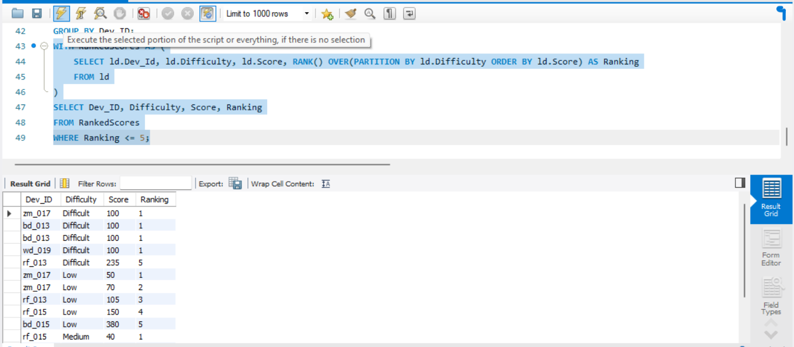
Query – 9)
Find Top 5 score based on each difficulty
level and Rank them in increasing order using
Rank. Display dev_id as well.
WITH RankedScores AS (SELECT Dev_ID,
Difficulty_level, Score, RANK()
OVER(PARTITION BY Difficulty_level
ORDER BY Score DESC) AS Rank FROM
Game_Data)
SELECT Dev_ID, Difficulty_level, Score,
Rank FROM RankedScores
WHERE Rank <= 5;
Analysis -- It assigns a rank to each score
based on descending order. Then, it selects the
developer ID, difficulty level, score, and rank
from the TopScores CTE where the rank is
less than or equal to 5.

Slide 14
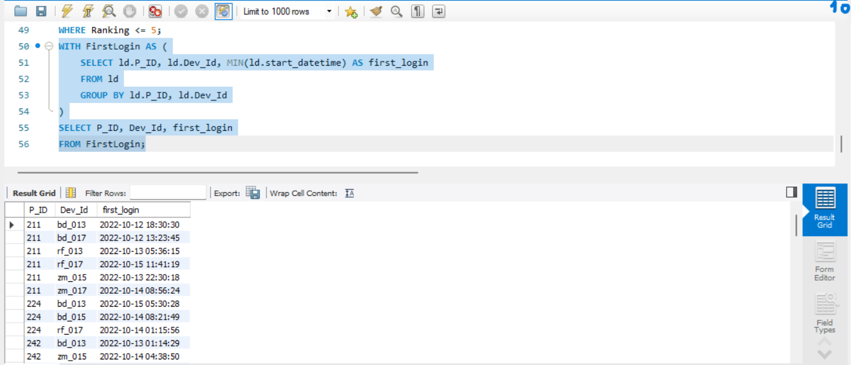
Query – 10)
Find the device ID that is first logged
in(based on start_datetime) for each
player(p_id). Output should contain player id,
device id and first login datetime.
WITH FirstLogin AS (SELECT P_ID,
Dev_ID, start_datetime, ROW_NUMBER()
OVER(PARTITION BY P_ID ORDER BY
start_datetime) AS RowNum FROM
Game_Data)
SELECT P_ID, Dev_ID, start_datetime AS
first_login FROM FirstLogin
WHERE RowNum = 1;
Analysis -- It assigns a row number to each
login record within each player's data, ordered
by the start_datetime. Then, it selects the
player ID (P_ID), developer ID (Dev_ID),
and the start_datetime corresponding to the
first login (identified by RowNum = 1) from
the FirstLogin CTE.

Slide 15
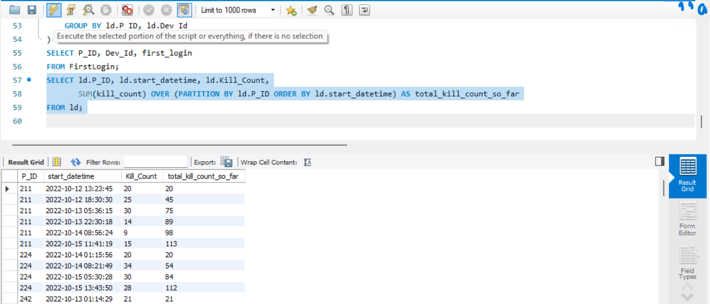
Query – 11)
For each player and date, how many kill_count
played so far by the player. That is, the total
number of games played by the player until that
date.
A)
window function
SELECT P_ID, start_datetime,
SUM(Kill_Count) OVER(PARTITION BY
P_ID ORDER BY start_datetime) AS
Total_Kill_Count
FROM Game_Data;
Analysis -- It utilizes the window function
SUM() with the OVER() clause to partition the
data by P_ID and order it by start_datetime. This
allows tracking the total kill count accumulated
by each player as they progress through the game
sessions, aiding in analyzing player performance
trends and engagement levels over time.

Slide 16
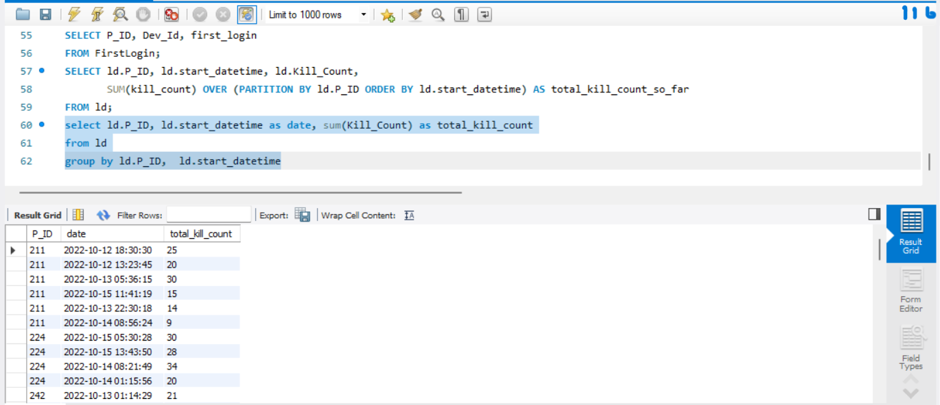
Query – 11)
B) without window function
SELECT P_ID, start_datetime,
sum(Kill_Count) as total_kill_countfrom ld
group by ld.P_ID, ld.start_datetime;
Analysis -- It utilizes a correlated subquery
to sum the Kill_Count values from the
Game_Data table for each player where the
start_datetime is less than or equal to the
start_datetime of the current row. This
provides a running total of kill counts for
each player as they progress through their
gaming sessions.

Slide 17
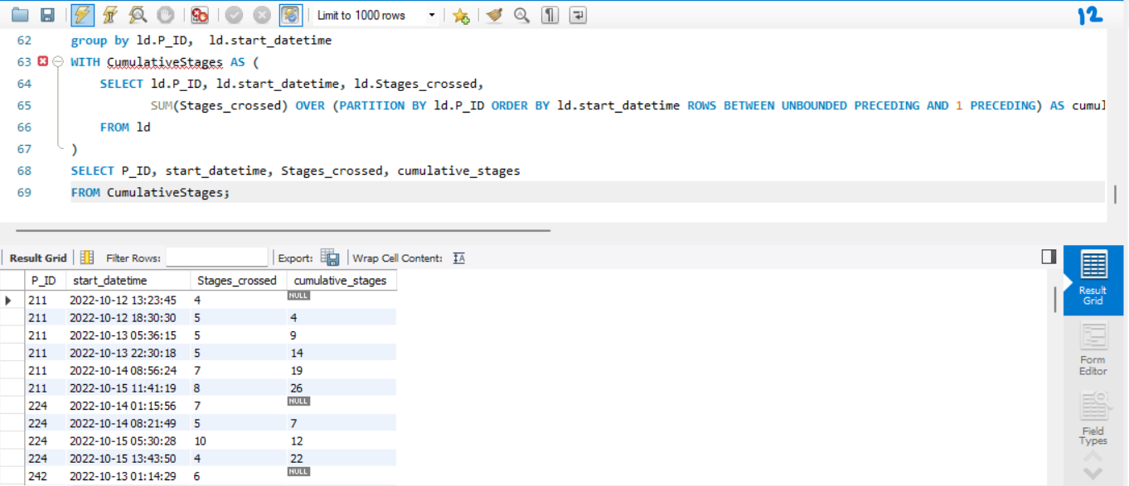
Query – 12)
Find the cumulative sum of stages crossed over a start_datetime for each player id but exclude the
most recent start_datetime
SELECT P_ID, start_time,
SUM(stages_crossed) OVER (PARTITION BY P_ID ORDER BY start_time ROWS BETWEEN UNBOUNDED PRECEDING AND 1
PRECEDING) AS cumulative_stages_crossed
FROM Level_Details;
Analysis -- It utilizes the SUM() function with the window function OVER() to sum the stages_crossed values from the Game_Data table for each player. The ROWS BETWEEN UNBOUNDED PRECEDING AND 1
PRECEDING clause specifies the range of rows to
include in the sum, which in this case is from the beginning of the partition (UNBOUNDED PRECEDING) up to the row immediately preceding the current row.

Slide 18
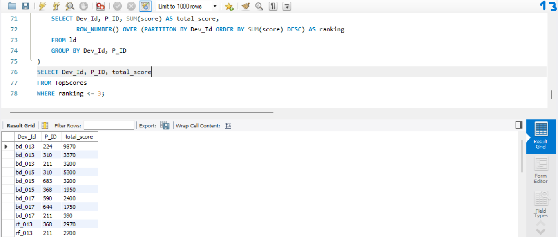
Query – 13)
Extract top 3 highest sum of score for each
device id and the corresponding player_id
WITH TopScores AS (SELECT P_ID,
Dev_ID, SUM(score) AS total_score,
ROW_NUMBER() OVER (PARTITION BY
Dev_ID ORDER BY SUM(score) DESC) AS
rank FROM Level_Details GROUP BY P_ID,
Dev_ID)
SELECT P_ID, Dev_ID, total_score
FROM TopScores
WHERE rank <= 3;
Analysis -- It then assigns a rank to each
player within each device based on their total
score, with the highest scorer receiving rank
1. The results are filtered to include only the
top 3 scorers for each device, showing their
P_ID, Dev_ID, and total_score.

Slide 19
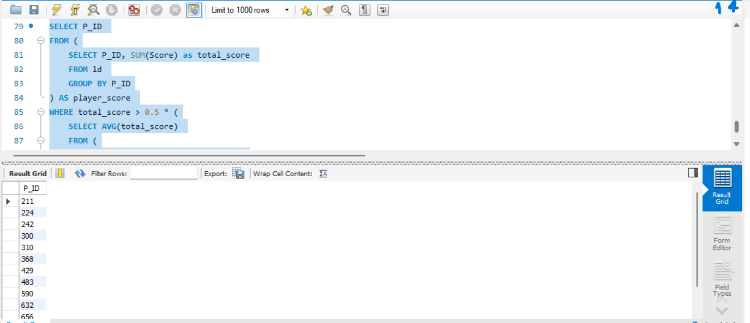
Query – 14)
Find players who scored more than 50% of the avg score scored
by sum of scores for each player_id.
SELECT P_ID FROM (SELECT P_ID, SUM(score) AS
total_score FROM Level_Details
GROUP BY P_ID) AS player_scores
WHERE total_score > 0.5 * (
SELECT AVG(total_score) FROM (
SELECT SUM(score) AS total_score
FROM Level_Details
GROUP BY P_ID
) AS avg_scores
);
Analysis -- It calculates the total score for each player in the inner
subquery and then filters the results based on the condition
specified.

Slide 20
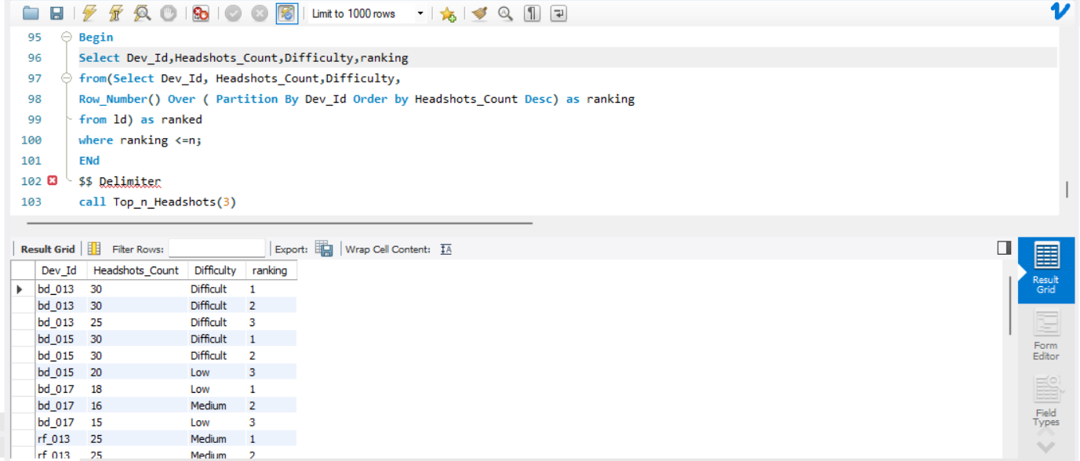
Query – 15)
Create a stored procedure to find the top `n` `headshots_count` based on each `Dev_ID`
and rank them in increasing order using `Row_Number`. Display the difficulty as well.
DELIMITER $$Create Procedure Top_n_Headshots( IN n int)
BeginSelect Dev_Id,Headshots_Count,Difficulty,ranking
from(Select Dev_Id, Headshots_Count,Difficulty,Row_Number() Over ( Partition By Dev_Id Order by Headshots_Count Desc) as rankingfrom ld) as ranked
where ranking <=n;ENd$$ Delimiter
call Top_n_Headshots(3)
Creating a stored procedure to find the top “n” headshot count based on Dev_Id gives insight about the player performance.

Slide 21
Summary
The project involved developing a database system for a gaming platform. Here's the key components and features:
Database Schema: The project includes a well-structured relational database schema with tables such as
`Player_Details`, `Level_Details`, and `Game_Data`, storing information about players, their game levels, and game statistics.
Data Analysis Queries: Various SQL queries were implemented to perform data analysis tasks, such as calculating total scores, finding top scores, identifying players with specific characteristics, and computing cumulative statistics.
Stored Procedures and Functions: PL/pgSQL stored procedures and functions were utilized to encapsulate complex SQL logic, improve code modularity, and enhance database performance. Functions like
`GetPlayerScoreSum` were created to compute aggregated values based on input parameters.
Window Functions: Window functions, such as `ROW_NUMBER()` and `SUM() OVER()`, were leveraged to perform advanced analytical operations like ranking scores, calculating cumulative sums, and retrieving data based on specific window partitions.
Optimized Queries: Efforts were made to optimize SQL queries for efficiency and performance, ensuring that data retrieval and processing tasks are executed swiftly, even with large datasets.
Overall, the project demonstrates proficiency in database design, SQL programming, and data analysis techniques, providing valuable insights into player behavior and game performance metrics.

Slide 22
THANK YOU

